Slide 1
“STEGANOGRAHY”
By
Sr. No. | NAME | ROLL NO.
1 | Vineet Tambe
DEPARTMENT OF
ELECTRONICS AND TELECOMMUNICATION ENGINEERING
PUNE INSTITUTE OF COMPUTER TECHNOLOGY
PUNE – 43

Slide 2
Introduction
Steganography is the art and science of writing hidden messages in such a way that no one, apart from the sender and intended recipient, suspects the existence of the message, a form of security through obscurity.
The word steganography is of Greek origin and means "concealed writing" from the Greek words steganos meaning "covered or protected", and graphein meaning "writing".
“Steganography means hiding one piece of data within another”.

Slide 3
Proposed System: Advantages
It is an imperceptible form of data hiding which goes unnoticed to the human eye.
Can be applied differently in digital image , audio file, video signal.
It can be applied to any type of image i.e. grayscale or rgb or rgb-alpha.

Slide 4
Steganography | Cryptography
Unknown message passing | Known message passing
Steganography prevents discovery of the very existence of communication | Encryption prevents an unauthorized party from discovering the contents of a communication
Little known technology | Common technology
Technology still being develop for certain formats | Most of algorithm known by all
Once detected message is known | Strong current algorithm are resistant to attacks ,larger expensive computing power is required for cracking
Steganography does not alter the structure | Cryptography alter the structure of the secret

Slide 5

Animation of project

Slide 6
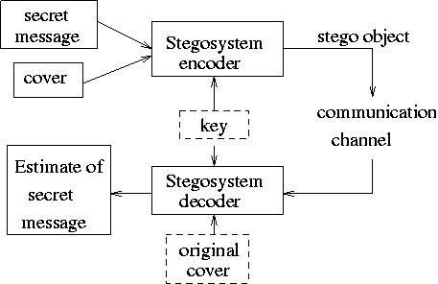
Flowchart

Slide 7
Source code explanation
I have defined two packages in project steganography: Encode and Decode.
In package Encode -
I have defined three classes – EmbedMessage, NewJFrame, Main
In package Decode -
I have defined three classes – DecodeMessage.
I import the required classes into other classes as and when required.
EmbedMessage –
This class is used to
Accept a message and a accept a cover image from the user.
It Embeds the message into the image by simple pixel manipulation. I have used LSB manipulation to achieve data hiding in the image.
This class also creates a new Jframe window for Embeding.

Slide 8
DecodeMessage –
This class is used to
Decodes the message present in the encoded image.
Gives an output image in .png format which the user can save.
This class also creates a new Jframe window for Decoding.
NewJFrame –
This class is used to
Create objects of class EncodeMessage and DecodeMessage
Calls member methods of EncodeMessage and
DecodeMessage
Main –
This class contains the psvm method and is used to create an object of class NewJFrame and calls member methods.

Slide 9
Result and conclusion
Interest in the use of steganography in our current digital age can be attributed to both the desire of individuals to hide communication through a medium rife with potential listeners, or in the case of digital watermarking, the absolute necessity of maintaining control over one's ownership and the integrity of data as it passes through this medium.
This increased interest is evidenced in the sheer number of available tools to provide easy steganographic techniques to the end user, as well as the proliferation of research and press on the topic.

Slide 10
Application and references
Confidential communication and secret data storing
Steganography provides us with:
Potential capability to hide the existence of confidential data
Hardness of detecting the hidden (i.e., embedded) data
Strengthening of the secrecy of the encrypted data
Protection of data alteration
Access control system for digital content distribution

Slide 11
Future scope
Steganography, though is still a fairly new idea. There are constant advancements in the computer field, suggesting advancements in the field of steganography as well. It is likely that there will soon be more efficient and more advanced techniques for Steganalysis.
A hopeful advancement is the improved sensitivity to small messages. Knowing how difficult it is to detect the presence of a fairly large text file within an image, imagine how difficult it is to detect even one or two sentences embedded in an image! It is like finding a microscopic needle in the ultimate haystack.

Slide 12
References
[1] An Introduction to Image Steganography Techniques. Date of Conference: 26-28 Nov. 2012
Date Added to IEEE Xplore: 16 May 2013 ISBN Information: INSPEC Accession Number: 13503058 DOI: 10.1109/ACSAT.2012.25 Publisher: IEEE.
[2] https://www.javatpoint.com
[3] https://www.geeksforgeeks.org/java/
[4] https://www.youtube.com/

